Slide 1


The Power of Enabling Technology
oTMS: Building Connected Transport Network

Slide 2
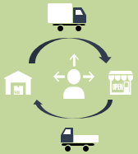

Chinese trucking remains fragmented & inefficient
6.7%
of GDP
789,000
1.8%
16M
RMB 4.25 trillion industry
Licensed carriers
+2.5m freight brokers
Top 10 market share
Heavy trucks
85% driver owned
Mature Markets – Europe
Emerging Market - China
Empty Capacity: 23%*
Empty Capacity >50%**
Carrier asset-managed networks
Spot rates & dynamic allocations
P&L responsibility on drivers
Low asset velocity - fixed backhaul rates
Increasing costs & slowing economy
* UK market – , Eurostat McKinnon 2014
** China Purchasing & Logistics Federation - 2014
Notes:
freight brokers match drivers for line-haul and last mile especially in tier 2 cities in public freight depots. Practices vary from province to province
Largest players – Deppon, CNEX Haou, CML, Rokin, PGL – 3-6B
There is not much consolidation going on – several TNT, SL, Menlo, Agility acquisitions had mixed success
As company grows bigger it finds difficult to manage – many informal practices exist
Compliance becomes an issue – you can get away with lot of things as a smaller company flying under the radar
It begs a a question – will the market ever consolidate, truck/network ownership will increase?
Individual truck ownership is also high in mature markets however key difference is truck capacity/routing is managed by a trucking company
Sell excess and buy under capacity on fairly dynamic basis – Tim.com, teleroute etc – backhaul especially in advance can be bought
China – paradox of overloading and underutilisation
Low asset velocity – unstable leadtimes
Overloading reaches its limits
Time is time and money is money – cost of living is increasing so does cost for a driver

Slide 3

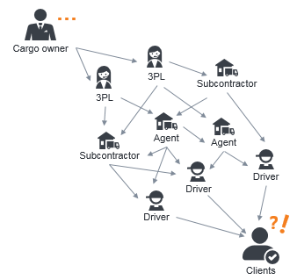
IT Evolution Journey in Different Markets
Mature Market (Europe & USA)
Traditional TMS
Mobile Apps
Cloud / SaaS
1
2
Effective optimization
Acquire multi-party structured data
Standardize & digitalize the processes
Collaborate –shipments & assets
Emerging Market (China)
Multi-layer outsourcing with little transparency
Fragmented processes
Unstructured “big data” – Excel No 1 TMS!
Notes:
Naturally IT adoption curve is different
In mature market mobile APP may be simple and effective add-on for driver-employee – directly linked with operator TMS – for example to provide POD
IoT was early in logistics – GPS on truck – empowers the driver. It also effectively replaces dedicated truck terminal
Cloud and SaaS gains acceptance in so called community TMS model – with pre-onboarded carriers
Traditional TMS penetration is low because of functionality mismatch:
route/load planning & optimisation, fleet/driver management etc In multi-layer outsourcing model have little relevance to companies that can afford it
Small players neither need it nor can afford it
Every trucking company follows own manual process – often different for different clients – there is no standardisation
Work is passed on to small vendors with little or no tech capability
Empower/engage your vendors and acquire real operations data – structured and directly from the source
Follow consistent process across vendor base – SOP/SLA enforcement
Open collaboration opportunities – share your assets/empty truck visibility , consolidate shipments – horizontal collaboration
Clean process and data is the foundation for effective optimisation/planning etc

Slide 4

oTMS Vision
CONNECTED TRANSPORT NETWORK
No. 1 and fastest growing cloud + mobile transport management platform in China
Daily user community:
1m shipments/month
+250 transport providers
+10 public carriers
+10,000 drivers
connect everyone on the standard workflow
remove complexity, cost & time
power real collaboration
Notes:
Over 20 shippers

Slide 5




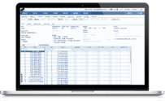






oTMS Workflow Design
Consignees
Retailers
Manufacturers
Driver
oTMS puts
all the parties in
the same loop
Carrier & Driver Connectivity
Whole execution chain engaged
Shipment Execution
Real-time track | GPS ePOD
Transport Cost Management
RFQ | Tariff | Spot Bids | Reciprocal Billing
Carrier Performance Management
Common Language SLA & KPI
Cloud Data Analytics
3PL/TSP
Last Mile
Linehaul
Notes:
Connect your existing vendors or invite the new ones from oTMS carrier pool
Single shipment intake/ no edit– shipper ERP or 3PL WMS/TMS
No EDI no order re-entry, no email – no edit
Fully functional TMS for small truckers
Shipment handover from mobile to mobile – between driver and hubs – support outsourced, less-than-full-truck operation
Consignee is in the same loop – either your client, sales/merchandisers or engineers – depending on the industry – experience B2C traceabilty
Subcontractor Identity is not disclosed

Slide 6


oTMS Growth Milestones
1 million/
month
250+
100
8
3 million
6
1
Companies
2015
12
Shipments
30
10
250k
Series A+ Investment
1
2014
12
8
Series A Investment
1
2013
Angel Investment
2011
Official oTMS launch
oTMS founded &
Product incubation

Slide 7







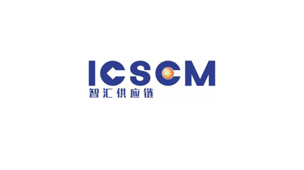


















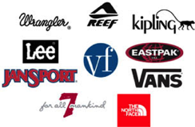



















oTMS Customer & Carrier Base
宿迁市鼎盛物流有限公司
Notes:
fashion apparel retail
Foods
Automotive
Pharma
Industrial
Target client:
shippers who work with multiple carriers directly
3PL & asset light carriers – who focus on empowering their vendors
Very fast adoption among local companies:
High product relevance to their needs
Fast decision making, ambition to digtalize
Very good value & fast implementation
Biz model – monthly subscription based on shipment volume – shipment pays once – so carriers & subcontractors, drivers etc use it for free

Slide 8





oTMS Case Study: BESTSELLER
Leading fast fashion brand retailer in China
Over 7000 own stores
+23 DC network
40 transport vendors
1,6 million retail shipments
4 million EC & o2o shipments
Complete digitalization of transport chain incl. retail, e-com, o2o, transfers/returns
Real visibility led to significant KPI improvements due to carrier accountability
Full freight cost control: paperless, reciprocal billing, no errors – pay carriers faster
50% admin cost savings: from routine daily ops and monthly billing and KPI
ROI < 6 months

Slide 9



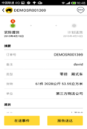




Track Shipments Status
Single version of the truth
Real time
3PL/TSP view
Driver APP Update
Cargo Owner view
Consignee view
Virtually eliminated traditional T&T workload via phone, excel, SMS
Reduced 50% human resources on T&T daily work
Driver smartphone GPS real-time track & trace

Slide 10
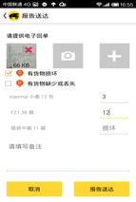
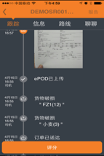
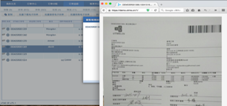
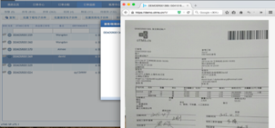
Instant ePOD from Driver
Speed up order to cash
Driver upload EPOD from KAKA
Vendor checking & accept
Client view
Consignee view
Geo-location, time, Geo-fencing limitation option
Reduced 90% workload to collect & verify POD
Faster Billing

Slide 11
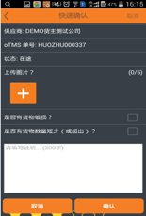

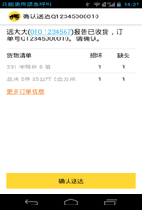
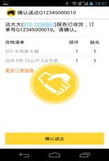
Go Paperless
Secure Bi-Party Goods Handover
Consignee check orders
Consignee generate QR code as delivery info
Driver check discrepancy
Driver confirm
Faster & Secure method to close shipments
Control warehouse & hub – transport handover
Control distributor territory - Distributor accountability

Slide 12
oTMS Benefits All Users
Consignee
Retailer & Manufacturers
3PL/TSP
Trucking Companies
Drivers
Cut 1-4 days from order to cash cycle by instant e-POD
Cut 15-30 days of net working capital
through auto ePOD & billing
Reduce admin cost RMB 1-4/shipment
Integrated tariff & billing 0.5 -2 % of cost
Optimize resources
Improve customer service levels
Reduce inventory through in-transit visibility
Fast deployment, ROI < 6 months
Instant deployment @ no cost

Slide 13
THANK YOU

